Slide 1
3.7 Reflection Principle
報告人 : 李振綱

Slide 2
3.7.1 Reflection Equality
3.7.2 First Passage Time Distribution
3.7.3 Distribution of Brownian Motion and
Its Maximum

Slide 3
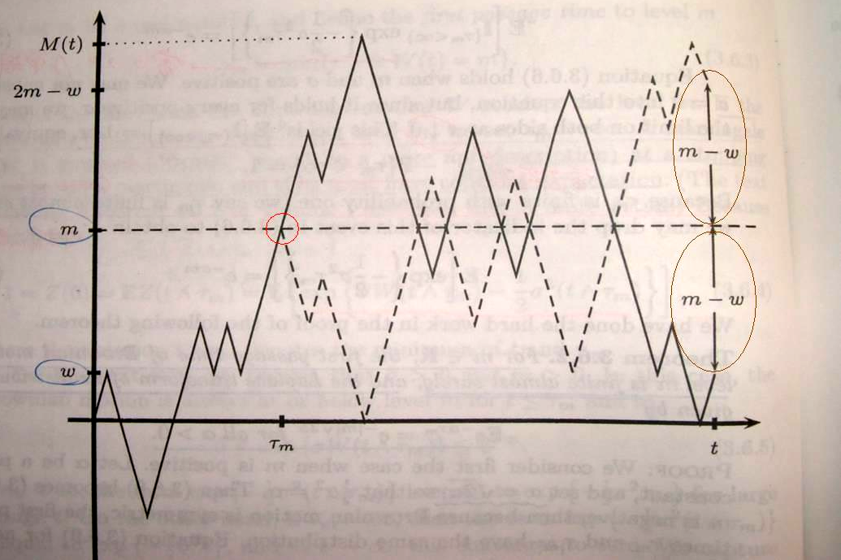
3.7.1 Reflection Equality
m>0 (3.7.1)

Slide 4


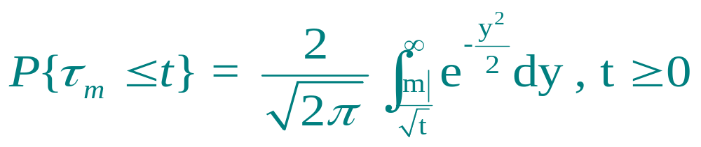
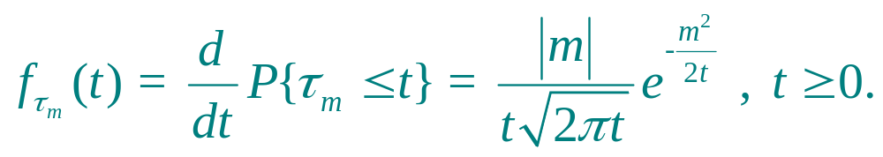
3.7.2 First Passage Time Distribution
Thm 3.7.1
For all , the random variable has cumulative distribution function
(3.7.2)
and density
(3.7.3)

Slide 5


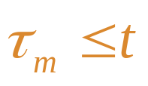
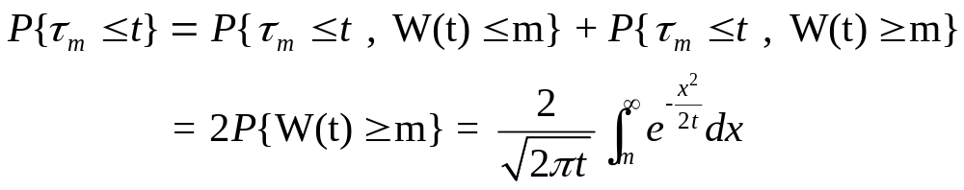
Proof Thm 3.7.1 :
We first consider the case m>0. We substitute into the reflection formula (3.7.1) to obtain
if , then we are guaranteed that .
so

Slide 6
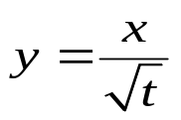


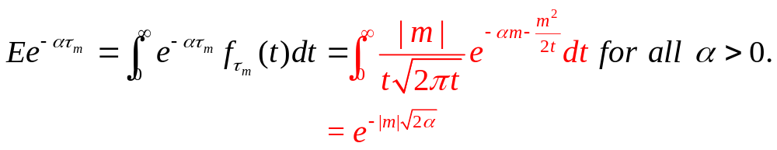
We make the change of variable in the integral,
and leads to (3.7.2) when m is positive. If m is negative,
then and have the same distribution, and (3.7.2)
provides the c.d.f of the latter. Finally, (3.7.3) is obtained by
differentiating (3.7.2) with respect to t.
Remark 3.7.2
From (3.7.3), we see that
(3.7.4)

Slide 7
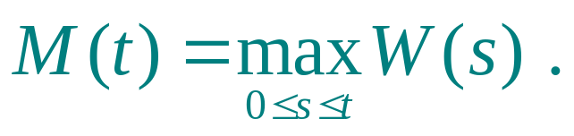

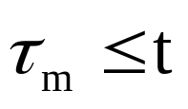
3.7.3 Distribution of Brownian Motion and Its Maximum
We define the maximum to date for Brownian motion to be
(3.7.5)
For positive m, we have if and only if .
(3.7.6)

Slide 8
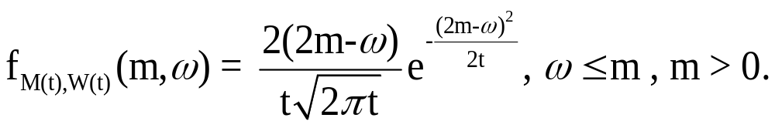
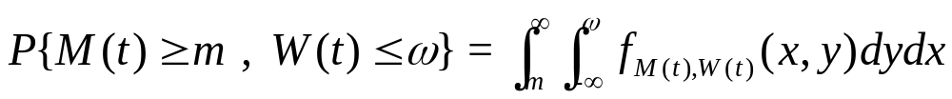
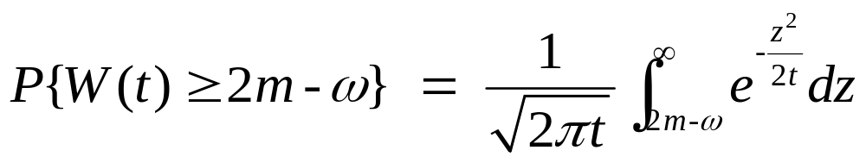
The joint distribution of W(t) and M(t)
Thm 3.7.3
For t>0, the joint density of (M(t),W(t)) is
(3.7.7)
proof :
Because
and

Slide 9
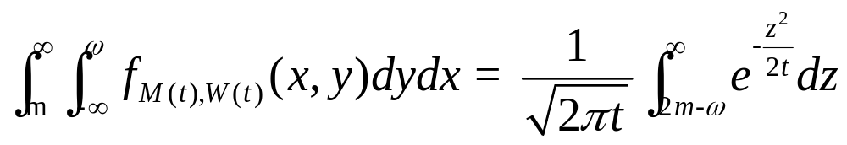
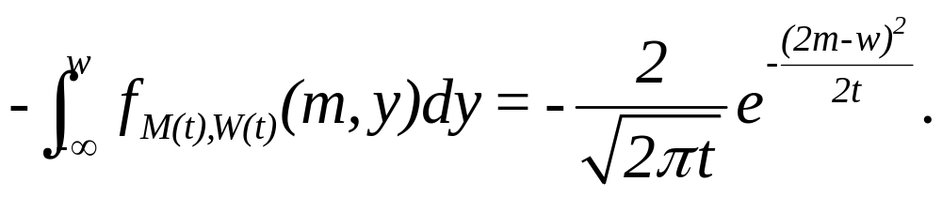

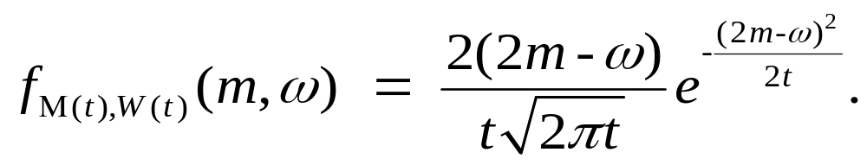
We have that
We differentiate first with respect to m to obtain
We next differentiate with respect to to see that

Slide 10

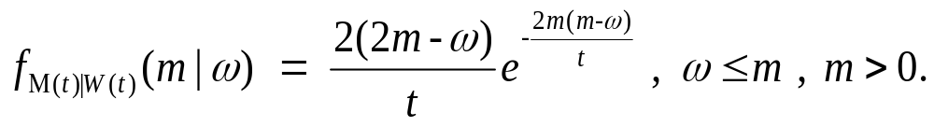
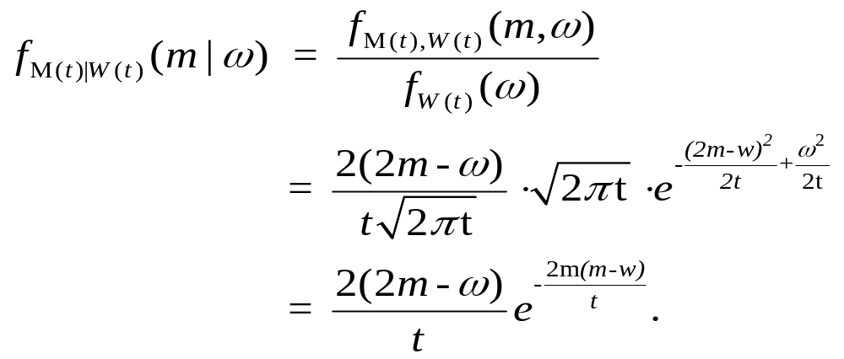
Corollary 3.7.4
The conditional distribution of M(t) given is
proof :

Slide 11
Thanks for your listening!!

